Slide 1

Defensive Security Project
by: Alejandro Lara, Angie Faz, Dario Anderson, Casey Cen, & Giovannie Mendoza

Slide 2
Table of Contents
This presentation contains the following resources:
Monitoring Environment
Windows Logs & Dashboard
Apache Logs & Dashboard

Slide 3
Table of Contents (cont.)
This presentation contains the following resources:
04
05
06
Attack Analysis for Windows & Apache
Project 3 Summary (Findings)
Q&A

Slide 4
Monitoring Environment
‹#›

Slide 5
Scenario
As a SOC analyst we work at a small company called Virtual Space Industries (VSI) which designs virtual-reality programs for businesses. Recently, there has been a rumor that a competitor, JobeCorp, may launch cyberattacks to disrupt VSI’s business. As an SOC analyst, we are tasked with using Splunk to monitor potential attacks on our systems and applications.The VSI products that we have been tasked with monitoring are an Apache web server, which hosts the administrative webpage, and a Windows operating system, which runs many of VSI’s back-end operations. The networking team has provided us with past logs to help our team develop baselines and create reports, alerts, dashboards, and more.

Slide 6

App Add In:
Whois XML IP Geolocation API
‹#›

Slide 7
Whois XML IP Geolocation API
Whois XML IP Geolocation API service identifies web visitors and users’ geographical location. IP geolocation APIs is a way we plan to gather IP location data from geolocation databases to then increase protection on already existing applications and systems.

Slide 8
Whois XML IP Geolocation API
The benefit of having this app is that by identifying an IP location we will be able to:
customize web experiences
prevent fraud
ensure regulatory compliance
pinpoints risk account and behaviors and much more.

Slide 9
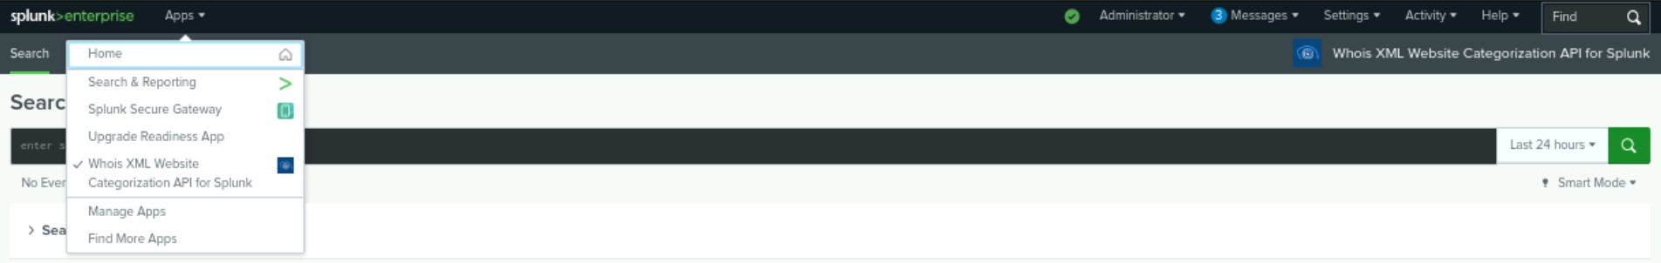
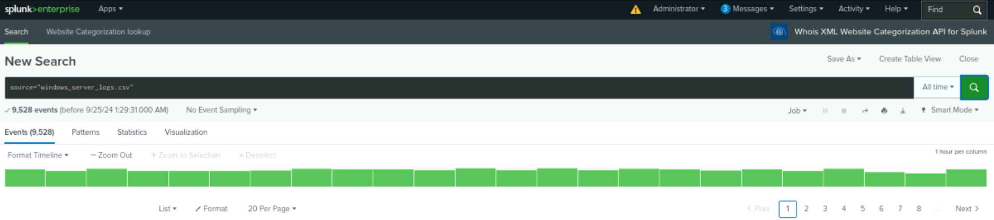
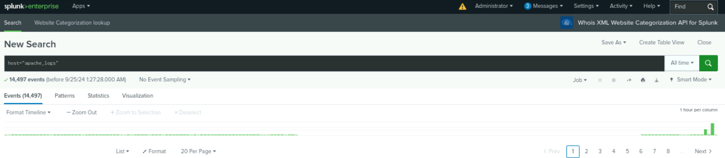
With Whois XML IP Geolocation API installed we are able to strengthen our defense abilities.

Slide 10
Logs Analyzed
Windows Logs
Apache Logs
1
2
Windows_server_logs.csv
Signature_id
Signature
Status
User
Severity
Apache_logs.txt
Clientip
Status
Useragent
Referer_domain
Method

Slide 11
Windows Logs
‹#›

Slide 12
Images of Reports & Alerts Created for Windows Logs

Slide 13
Reports-Windows
Designed the following reports:
Report Name | Report Description
Signature ID Table | Shows each signature with their matching ID’S
Severity Chart | Displays the number count of events by severity, Informational and high
Status Chart | Shows status events by Success or Failure

Slide 14
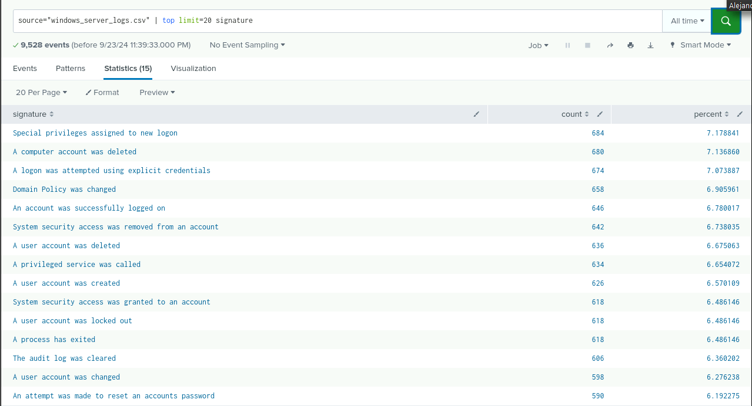
Signature ID Table

Slide 15
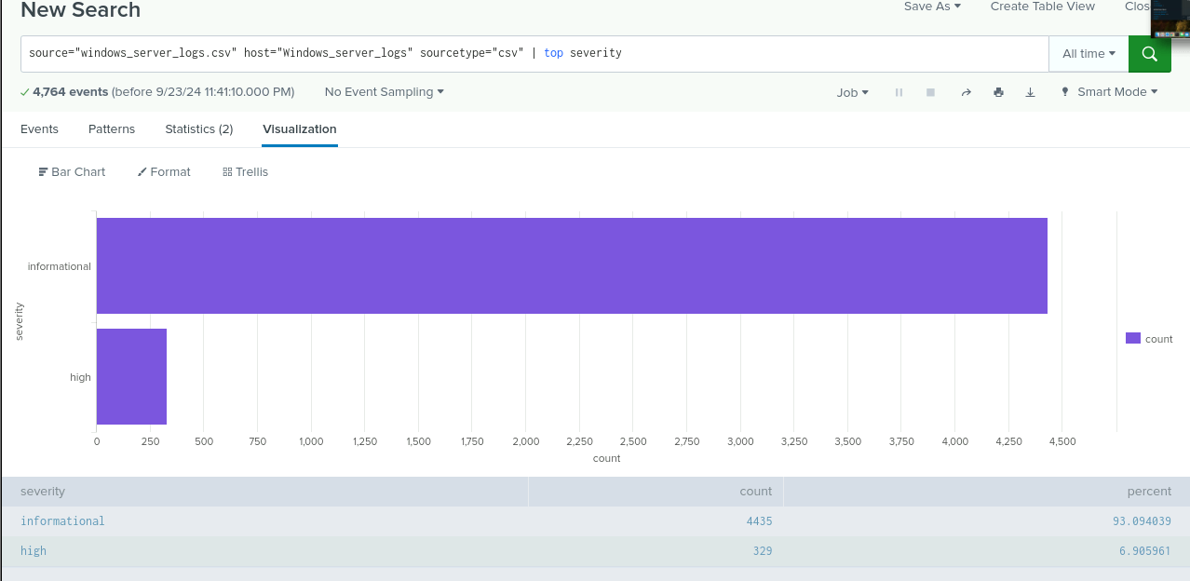
Severity Chart

Slide 16
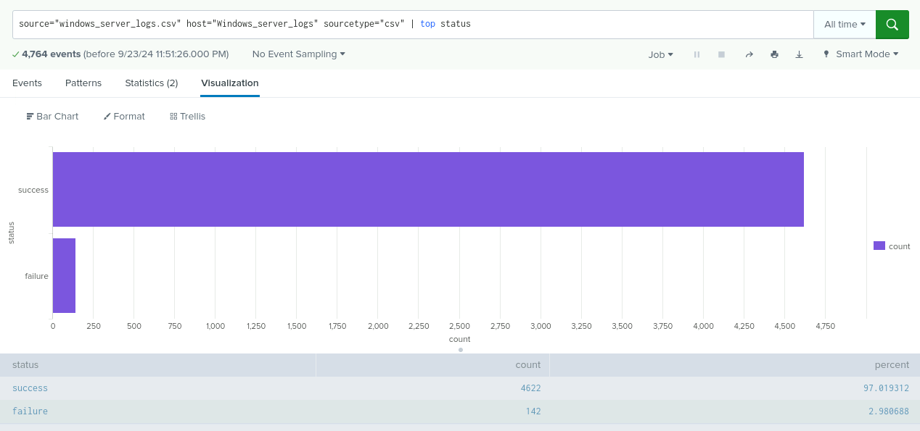
Status Chart
Success vs Failure

Slide 17
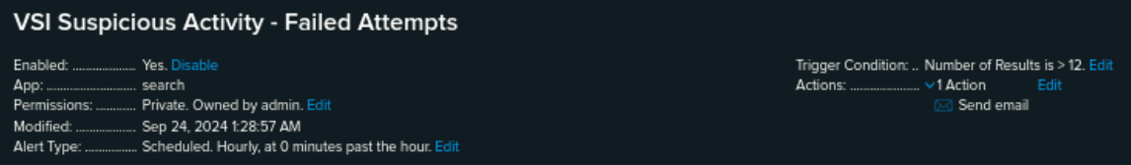
Alerts—Windows
Designed the following alerts:
Alert Name | Alert Description | Alert Baseline | Alert Threshold
VSI Suspicious Activity | It watches failed attempts on the server | 2-10 | 12
JUSTIFICATION: Given that our data followed a normal distribution without any extreme outliers, we established our baselines based on values from the upper end of the dataset. By averaging those upper values, we defined our baselines.

Slide 18
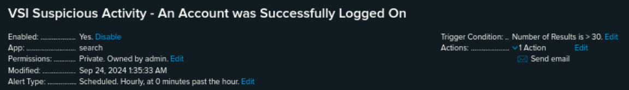
Alerts—Windows
Designed the following alerts:
Alert Name | Alert Description | Alert Baseline | Alert Threshold
VSI Accounts Successfully Logged On | Alert for the accounts that have logged in successfully | 8-21 | 30
JUSTIFICATION: After analyzing the average per hour, we established a threshold of 30. This threshold may be adjusted based on future evaluations.

Slide 19
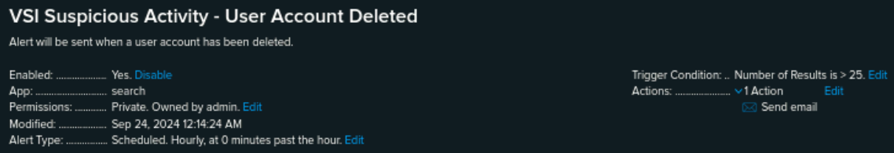
Alerts—Windows
Designed the following alerts:
Alert Name | Alert Description | Alert Baseline | Alert Threshold
VSI Suspicious Activity- User Account Deleted | Alert for suspicious numbers of accounts being deleted on the server | 9-17 | 25
JUSTIFICATION: We set this threshold high enough to prevent frequent alerts from normal activity, but low enough to trigger warnings for any suspicious behavior.

Slide 20
Dashboard - Windows
‹#›

Slide 21
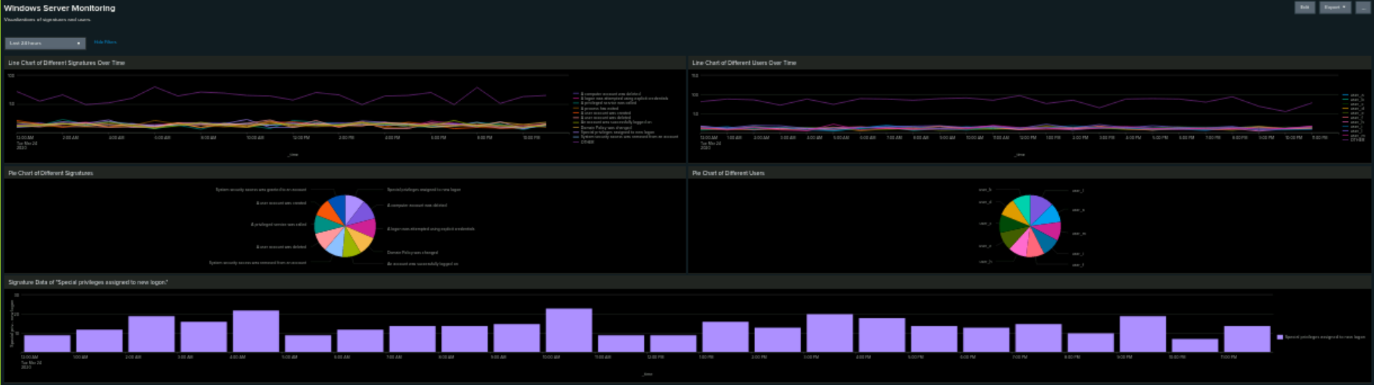
Windows Server Monitoring Dashboard

Slide 22
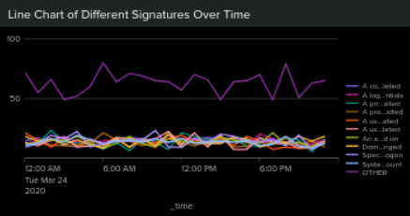
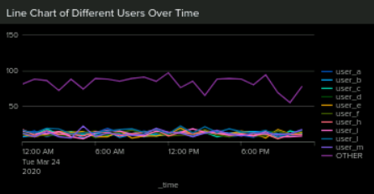
Line Chart for Different Signatures and Users Over Time
Over time Different Signatures and Different Users continuously overlapped each other with the category of OTHER at the highest count.

Slide 23
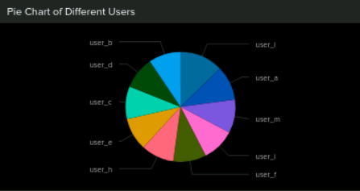
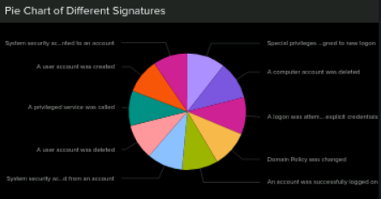
Pie Chart for Different Signatures & Different Users
Count for Different Signatures was within the range of 309-342 hile the count for Different Users was within the range of 263-354.

Slide 24
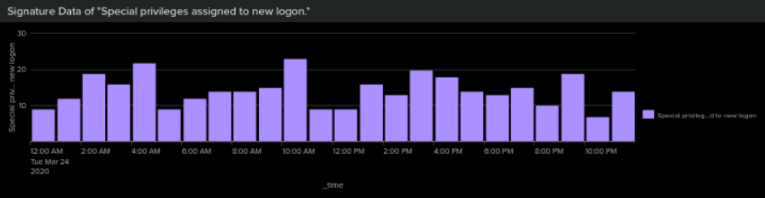
Single Point Data of Special privileges assigned to new logon.

Slide 25
Apache Logs
‹#›

Slide 26
Images of Reports & Alerts Created for Apache Logs

Slide 27
Reports—Apache
Designed the following reports:
Report Name | Report Description
HTTP Methods | Shows a table of different HTTP methods (GET, POST, HEAD)
TOP 10 Domains Count of each HTTP response | Shows top 10 domains that refer to VSI’s website
Count of each HTTP response | Shows the count of each HTTP response code

Slide 28
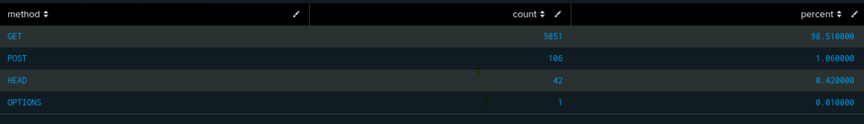
HTTP Methods

Slide 29
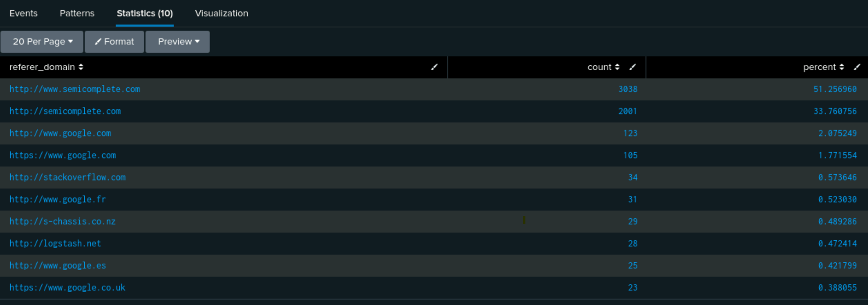
Top 10 Domains

Slide 30
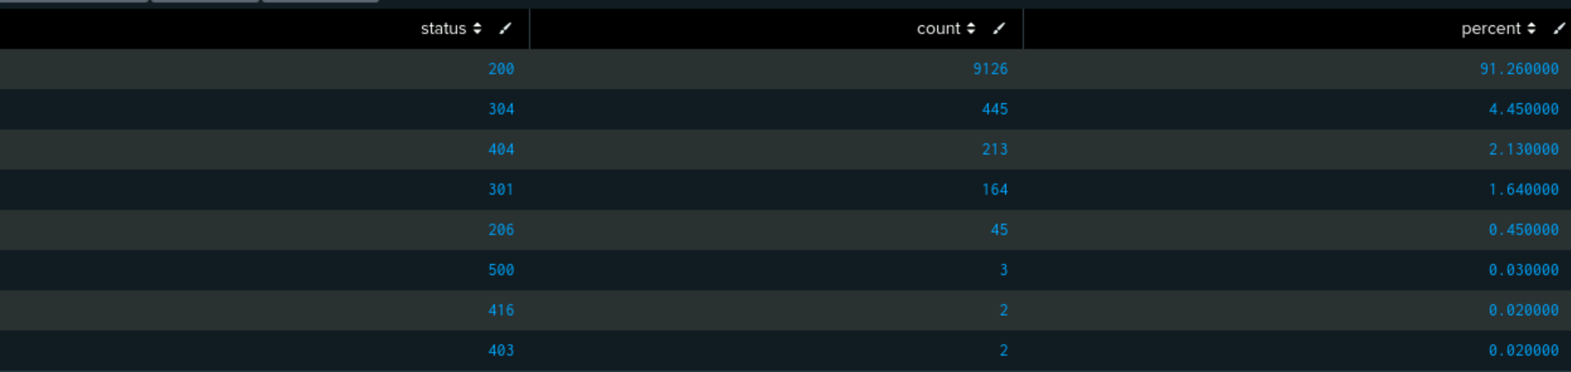
Count of each HTTP response

Slide 31
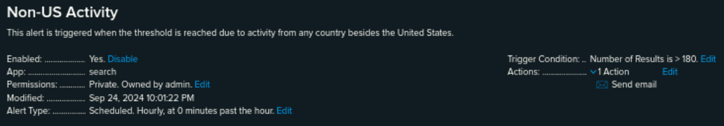
Alerts—Apache
Designed the following alerts:
Alert Name | Alert Description | Alert Baseline | Alert Threshold
Non-US Activity | It sends an alert and an email when the threshold is surpassed. | 80 | 180
JUSTIFICATION: After examining the logs and assessing the hourly averages, we decided that a threshold of 180 would be appropriate. This allows for some spikes while still notifying us of any unusual activity.

Slide 32
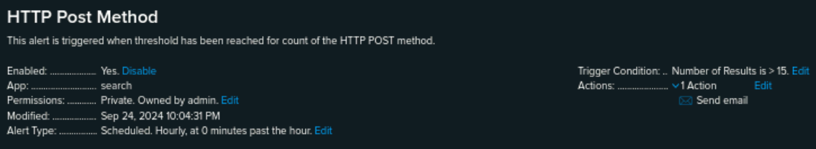
Alerts—Apache
Designed the following alerts:
Alert Name | Alert Description | Alert Baseline | Alert Threshold
HTTP POST | It issues an alert and sends an email when the hourly threshold for HTTP POST methods is exceeded. | 1-7 | 15
JUSTIFICATION: The logs we analyzed helped us determine the average, which guided our choice of threshold for this alert.

Slide 33
Dashboard - Apache
‹#›

Slide 34
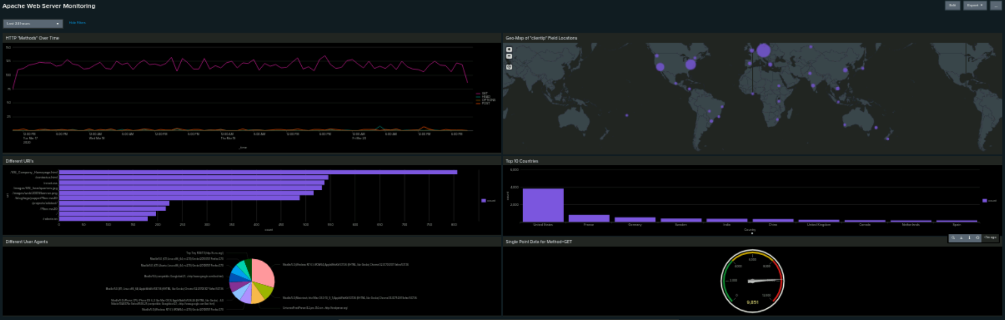
Apache Web Server Dashboard

Slide 35
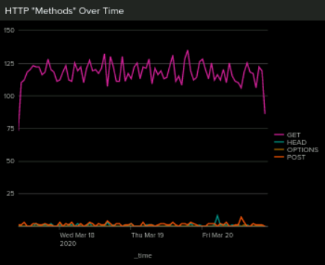
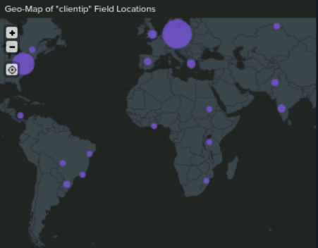
Geo-Map of clientip
United States and Ukraine noted as countries with most activity
HTTP Methods Over Time
Line Chart
GET Method had the most peaks

Slide 36
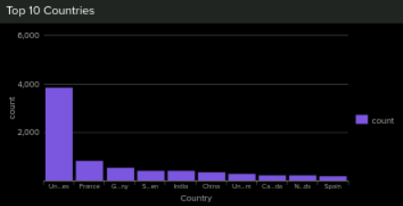
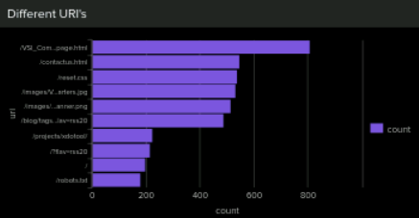
Top 10 Countries
United States #1 at 3,800
Different URI’s
/VSI_Company_Homepage.html #1 at 807

Slide 37
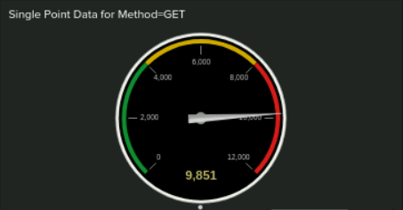
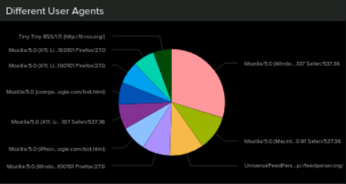
Different User Agents
Mozilla 5.0 at 1,044 which was 29.7%
Single Point Data for Method=GET
High Peak of 9,851

Slide 38
Attack Analysis
for Windows Server and Apache
‹#›

Slide 39
Attack Summary—Windows
Summarize your findings from your reports when analyzing the attack logs.
Report analysis for severity:
increase in severity
Report analysis for failed activities:
no significant change
Notes:
Report analysis for severity: There was a significant increase in high severity from 9% to 20%.
Report analysis for failed activities: There was no significant change in failed activities. There was only a small decrease from 3% to 2%.

Slide 40
Attack Summary—Windows
Summarize your findings from your alerts when analyzing the attack logs. Were the thresholds correct?
Alert analysis for failed windows activity
suspicious activity detected- 3/25/2020 at 8am with 35 events
Alert triggered (threshold 12)
Alert analysis for successful logins
suspicious activity detected- 3/25/2020 at 11am with 196 events
Alert triggered (threshold 30)
Alert analysis for deleted accounts
No suspicious activity

Slide 41
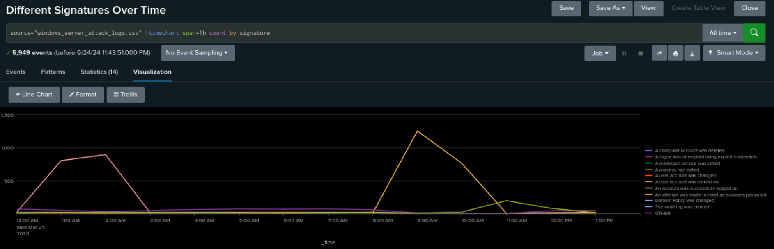
Attack Summary—Windows
Summarize your findings from your dashboards when analyzing the attack logs.
Dashboard analysis for time chart of signatures:
suspicious activity found for:
‘an attempt was made to reset an account’s password’(1am-2am)
‘a user account was locked out’ (9am-10am)
Notes:
A user account was locked out= 896
attempt was made to reset an account password both stood out= 1,258

Slide 42
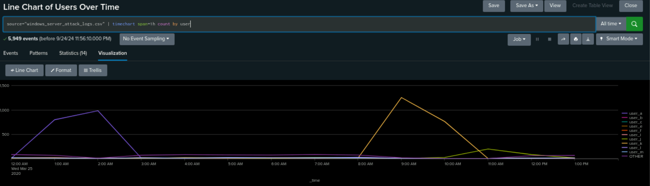
Attack Summary—Windows
Summarize your findings from your dashboards when analyzing the attack logs.
Dashboard analysis for users
User_A: (1am-2am)
User_K: (9am-10am)
Notes:
User_A: 984
User_K: 1256

Slide 43
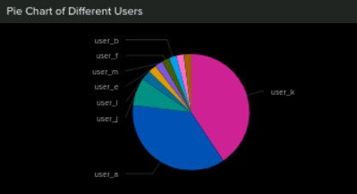
Attack Summary—Windows
Summarize your findings from your dashboards when analyzing the attack logs.
Dashboard analysis:
User_A= ‘user account was locked out’
User_K= ‘attempt was made to reset an account password’

Slide 44
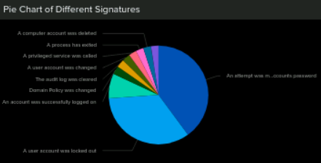
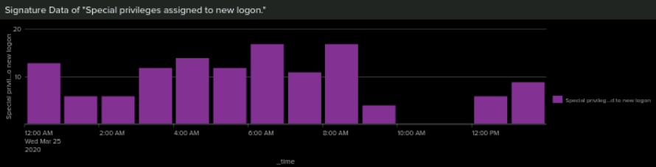
Other Screenshots of Windows Attack Logs

Slide 45
Attack Summary—Apache
Summarize your findings from your reports when analyzing the attack logs.
HTTP methods
GET method decreased significantly
POST method increased
Referrer domains
no suspicious activity
HTTP response codes
status 200: decrease
status 304: increase
status 404: increase
Notes:
The GET method decreased significantly from 98% to 70%. The POST method increased 1% to 29%.
Status 200 decreased from 91% to 83%
Status 304 increased from 4% to 0.8%
Status 404 increased from 2% to 15%

Slide 46
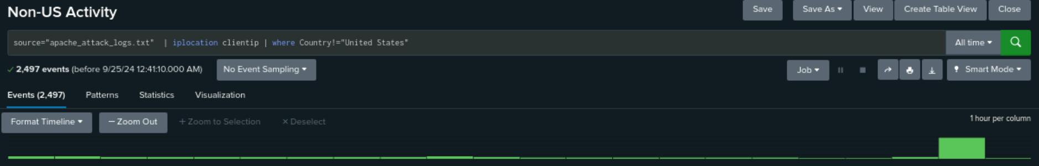
Attack Summary—Apache
Summarize your findings from your alerts when analyzing the attack logs. Were the thresholds correct?
Alert analysis for international activity:
suspicious activity on 3/25/2020 at 10pm with 937 events
alert triggered (threshold 180)

Slide 47
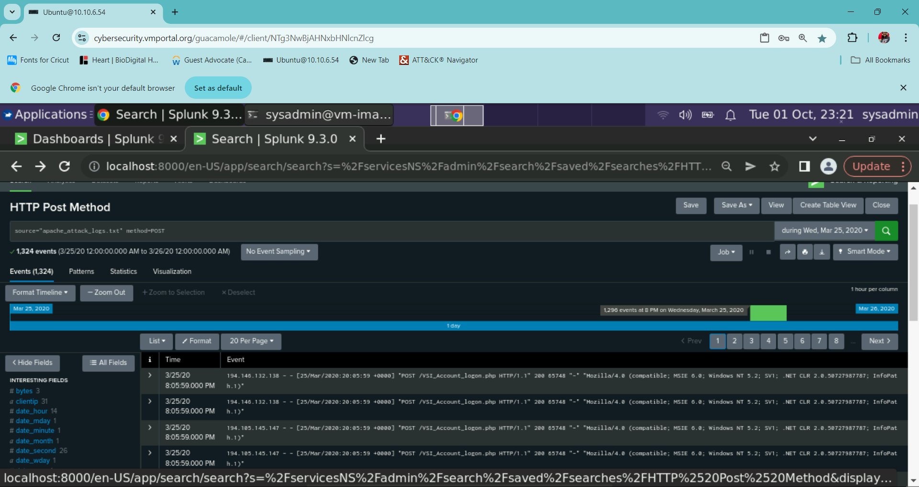
Attack Summary—Apache
Summarize your findings from your alerts when analyzing the attack logs. Were the thresholds correct?
Alert analysis for HTTP POST activity:
suspicious activity on 3/25/2020 at 8pm with 1296 events
alert triggered (threshold 15)

Slide 48
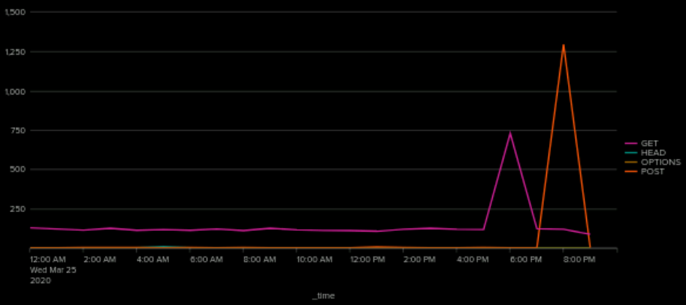
Attack Summary—Apache
Summarize your findings from your dashboards when analyzing the attack logs.
Dashboard analysis for time chart of HTTP methods
GET and POST method both had sharp increase
Notes:
GET method: 4:30pm-6pm with 729 events
POST method: 7pm-8pm with 1296 events

Slide 49
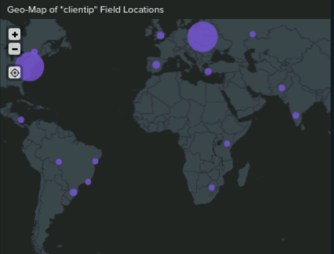
Attack Summary—Apache
Summarize your findings from your dashboards when analyzing the attack logs.
Dashboard analysis for cluster map
New York
Washington D.C., Virginia
Kev, Ukraine
Kharkiz, Ukraine
Notes:
High volume of activity:
New York (584)
Washington D.C., Virginia(668)
Kev, Ukraine(439)
Kharkiz, Ukraine (432)

Slide 50
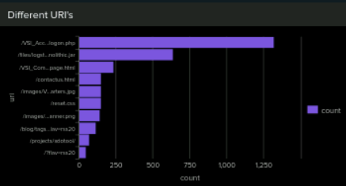
Attack Summary—Apache
Summarize your findings from your dashboards when analyzing the attack logs.
Dashboard analysis for URI Data
The VSI_Account_logon.php increase
The_files_log_stash increase
Notes:
The VSI_Account_logon.php has a significant count increase. Possibly attempting multiple logons.
The_files_log_stash also had a significant increase at 638. Possibly attempting to transfer/capture data.

Slide 51
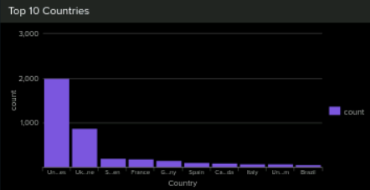
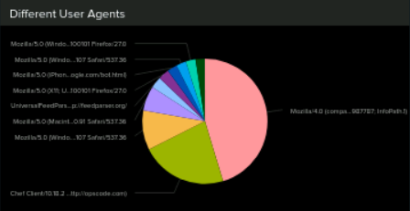
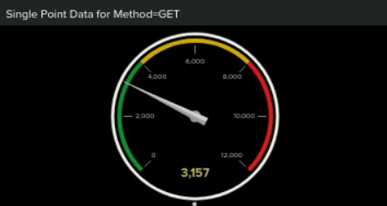
Other Screenshots of Apache Attack Logs

Slide 52
Project 3 Summary
We had multiple attacks on 3/25/2020: brute force
To protect VSI from future attacks
- 2 factor authentication and locking out user after a certain amount of failed login attempts

Slide 53
Time for any Q&A
‹#›

